Slide 1
DATA COMMUNICATION & NETWORK CSE338/CSE438 Submitted to Nova Ahmed
Md. Maruf Billah ID: 1530671042

Slide 2
WebRTC

Slide 3
What is WebRTC
Web Real-Time Communications (WebRTC) is an open source project created by Google to enable peer-to-peer communication in web browsers and mobile applications through application programming interfaces. This includes audio, video, and data transfers

Slide 4
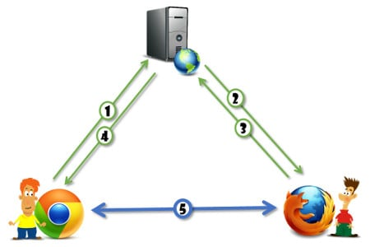
How it works

